Slide 1

Videogame market study
02/02/2016
AAD (Advanced Analytics Deptartment)

Slide 2
Index
Introduction
Business case
Presentation for the CEO
Presentation for the data science team
Conclusions

Slide 3
1. Introduction
The launched Xbox One is underperforming.
One of the key identified points on why it is underperforming compared to the competitors was the lack of console exclusive video games launched.
We wish to invest 75 million USD to develop a console selling video game in Q4 2016.

Slide 4
2. Business case
We wish to develop a best seller game for our new XBOX .
For that we have to understand the following:
What genre tends to sell the best?
What publishers sell the most?
Who are our competitors?
What types of games have been best sellers in the past?
What is our safest bet in terms of: Genre and Publisher?
After this, we will assign the data science team to generate a regression model to predict global sales for the selected genre and publisher for next year.

Slide 5
To answer the previous questions we have leveraged the "Video Game Sales" dataset from user GregorySmith in Kaggle.
The dataset is a ranking of top seller games containing 16k rows with the following information:
Rank - Ranking of overall sales
Name - The games name
Platform - Platform of the games release (i.e. PC,PS4, etc.)
Year - Year of the game's release
Genre - Genre of the game
Publisher - Publisher of the game
NA_Sales - Sales in North America (in millions)
EU_Sales - Sales in Europe (in millions)
JP_Sales - Sales in Japan (in millions)
Other_Sales - Sales in the rest of the world (in millions)
Global_Sales - Total worldwide sales.
Note: data is incomplete for 2015 and 2016.

Slide 6
3. Presentation for the CEO

Slide 7
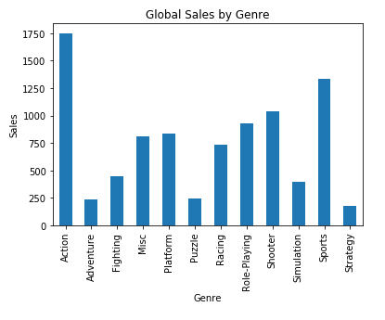
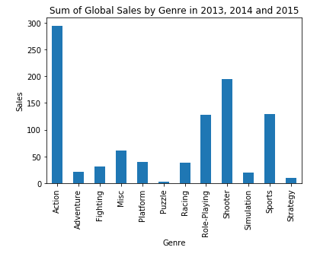
Genre analysis
Looking into the sales at a global level, we clearly see that Action type games are the best selling genre by a mergin. This is still the case when exploring the sales in the recent years. By looking into 2013, 2014 and 2015 we also see that the Shooter genre is on the rise.

Slide 8
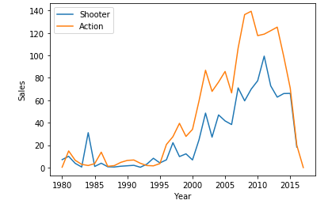
Genre analysis
Comparing the two most performance genres, we can see action type games still outperform shooter games and we expect this to continue to be the case based on the sales of the recent years.

Slide 9
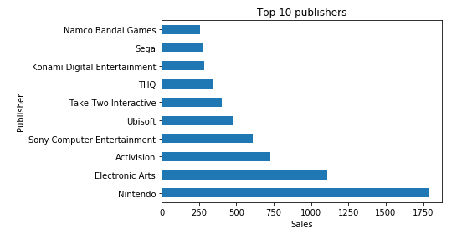
Publisher analysis
The graph gives a clear perspective on which are the most performant publishers and whom we should partner with.
Excluding Nintendo, who is our competitor, we can consider Electronic Arts and Activision as our main potential partners.

Slide 10
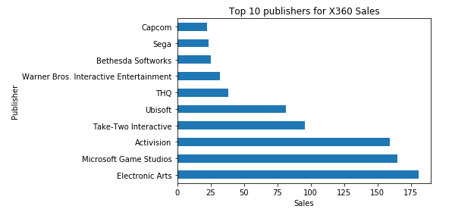
Publisher analysis
We can see that analyzing the sales of X360 games Electronic Arts and in-house developed games are both performant.
If we want to cater to the greater audience we propose to partner with Electronic Arts or Activision.

Slide 11
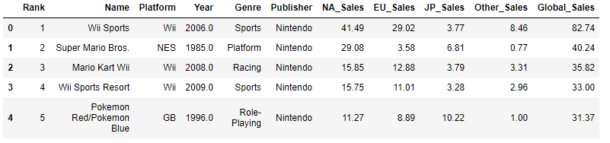
Games analysis
As seen in the publisher analysis, Nintendo is a very performant game publisher, but they develop for the younger audience, which differs from out teen to adult based audience and thus don't think taking into account their games provides much value.

Slide 12
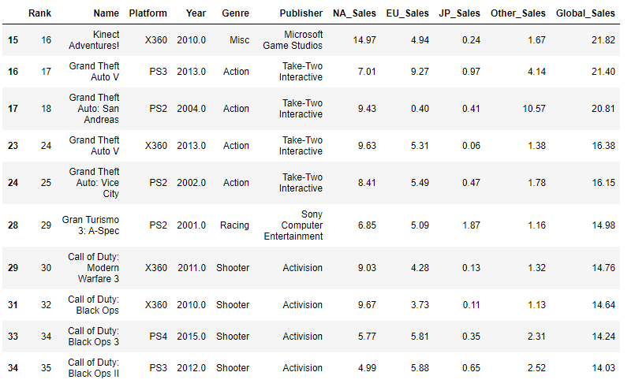
Games analysis
Looking into the best selling games, excluding Nintendo we can see that the same games sell for both Microsoft and our main competitor Sony. This is to be expected as we share core audience.
Activision provides top selling games for both consoles, and as we have seen previously it is one of the best selling publishers.

Slide 13
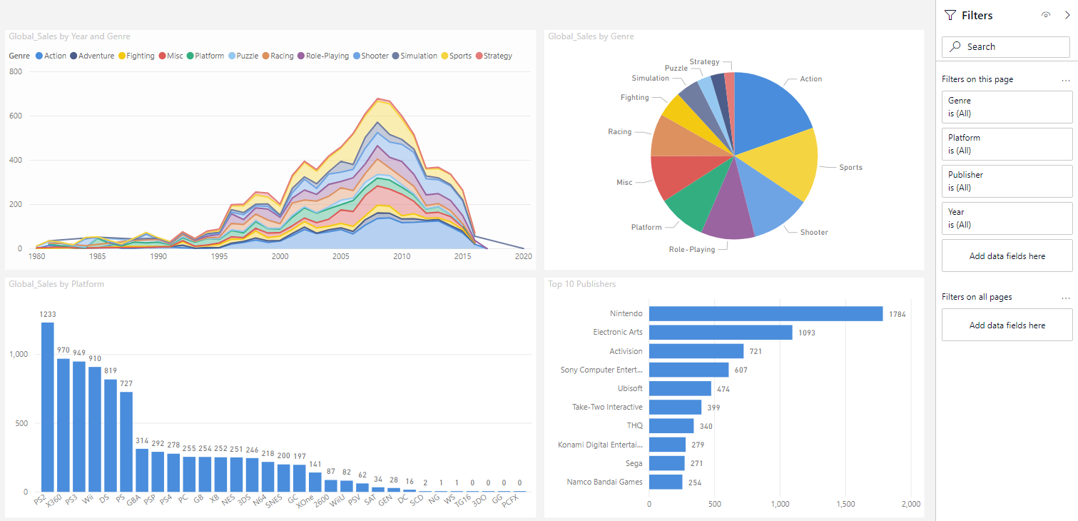
Further exploration
To perform some data analysis, please feel free to use the provided interactive dashboard built in Power BI.

Slide 14
4. Presentation for the data science team
Note: it is assumed that the data science teams also attended the presentation for the CEO.

Slide 15
Objective
To estimate the earnings for next year and support our decision to invest in Activision we want to Predict the estimated earnings of a new exclusive Call of Duty Game for the XBOX One.
For that we will build a regression model that estimates Global Sales based on the features of our dataset.

Slide 16
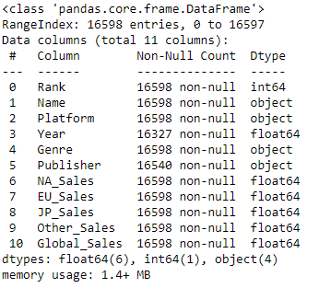
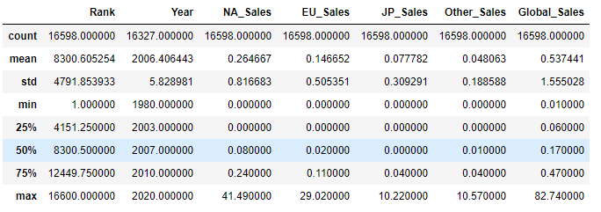
Data info
Our dataset contains 11 columns, 4 of which are categorical and the rest numerical. To gain some understanding on the distribution of out dataset, we will look into the counts of our main categorical columns: genre, publisher and year.

Slide 17
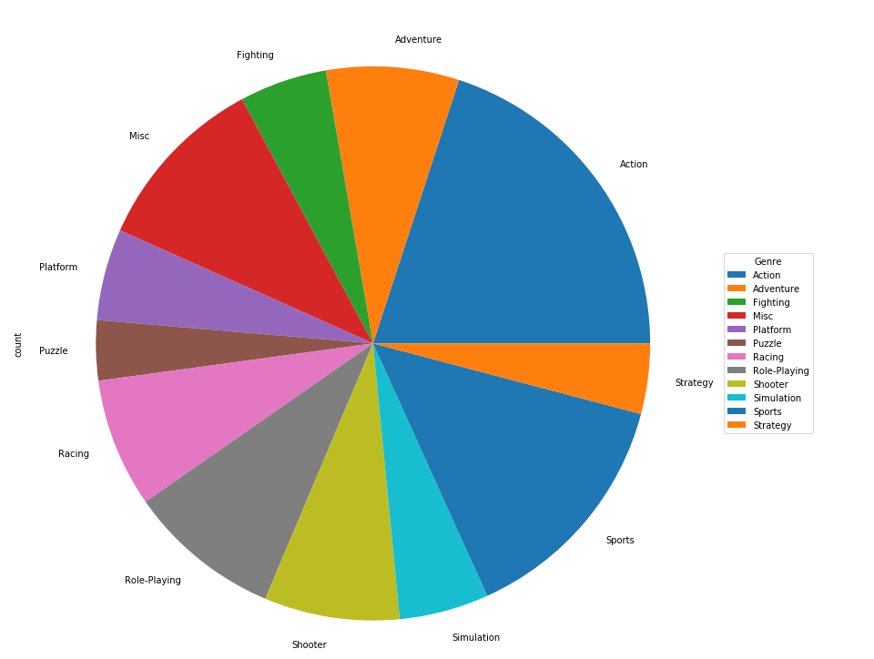
Counts: by genre

Slide 18
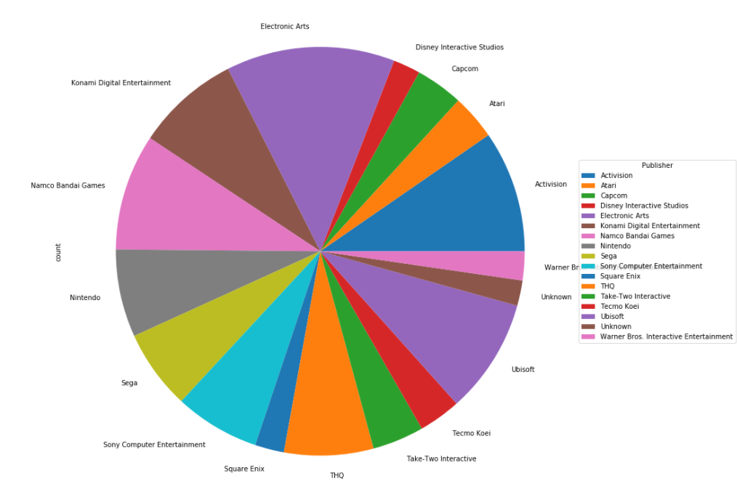
Counts: by top publishers (more than 200 top ranking games accross all platforms)

Slide 19
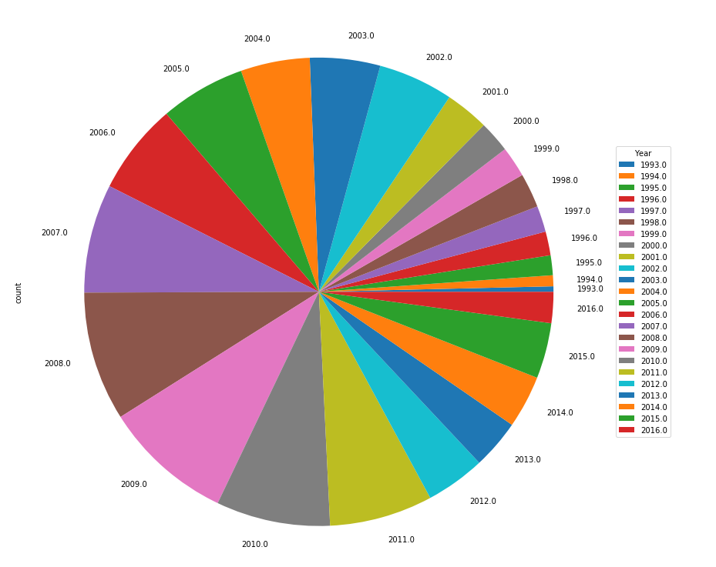
Counts: by years

Slide 20
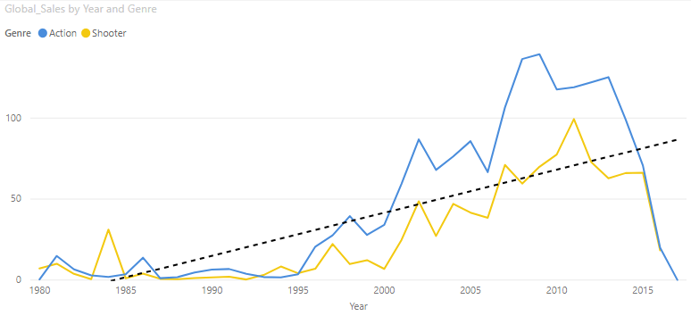
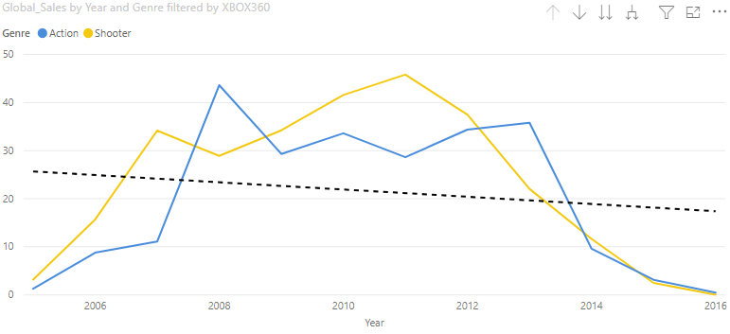
Genre analysis
As explored in the CEO presentation, Action and Shooter genres outperform the rest. This is even more true in the recent years, and as we can see from the trend line in the graph to in the top right, the sales are increasing for these two genres.
The graph blow that shows that Shooter sales for the XBOX360 outperformed Action type games for years 2010, 2011 and 2012, showing that these games are especially popular amongst the XBOX clients.

Slide 21
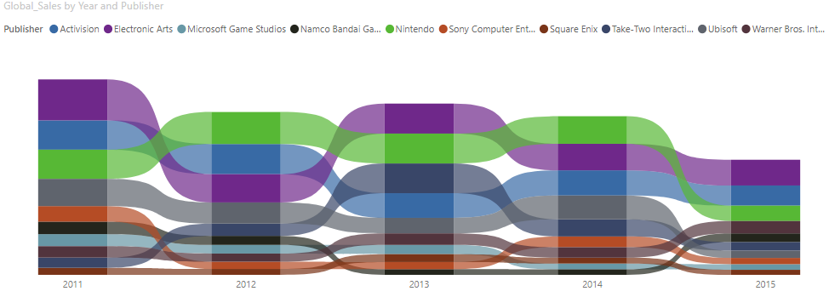
Publisher analysis
As seen from the ribbon chart below, both Activision and Electronic Arts have performed consistently and well in the past few years. Making them both very valuable choices.

Slide 22
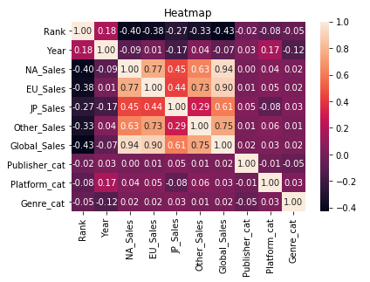
Correlation matrix
The following is the correlation matrix after label encoding the categorical columns.
We can see correlations are low, but we suspect that after applying some transformations these can grow.

Slide 23
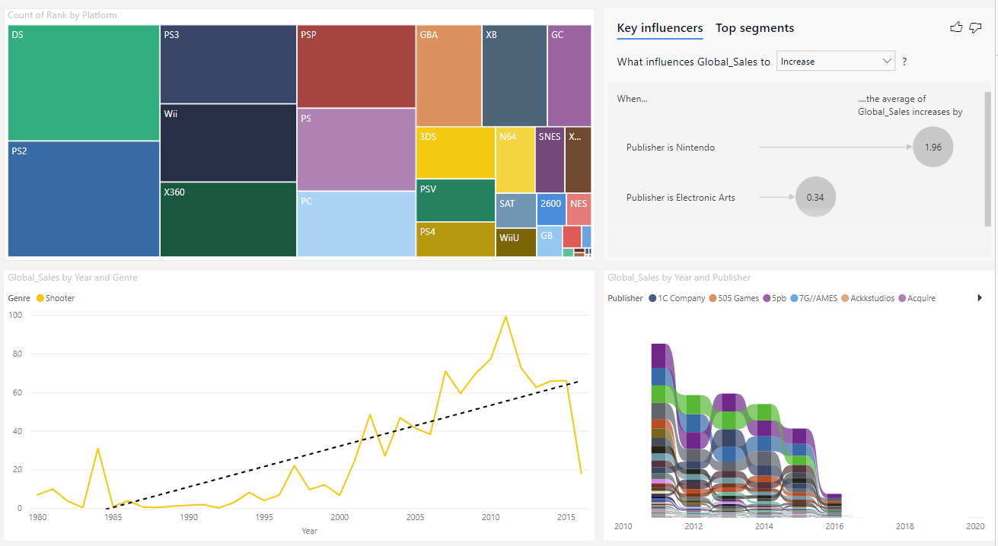
Further exploration
To perform some data analysis, please feel free to use the provided interactive dashboard built in Power BI.

Slide 24
Conclusions
Based on the analysis by: Genre, Publisher and Game. We believe our safest bet is to sign an exclusivity contract for a new shoorter type game with Activition.
The shooter type game sells very well and caters to our core audience, more importantly, it is also very popular amongst our competitor's platform and thus will attract public from them.

